Slide 1
Bing Ads Remarketing Feature

Slide 2
Session Overview
What Is Remarking?
Benefits Of Remarketing For Advertisers
How To Setup Remarketing
FAQs
Additional Considerations

Slide 3
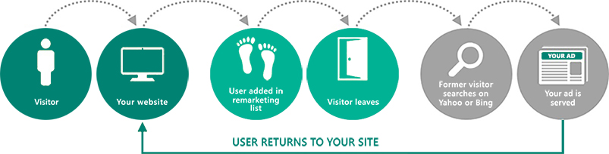
What Is Remarketing?
Remarketing in Paid Search enables advertiser to improve their return on investment (ROI) by optimizing campaigns for specific audiences, like high-value customers who had visited their website before
With remarketing, advertisers are able to:
Appeal to all or a subset of visitors who did not convert and stay top of mind
Exclude, upsell, or cross-sell offers to existing customers
Drive higher ROI

Slide 4
Benefits Of Remarketing for Advertisers
Better Targeting*:
Reaches highly qualified end users who are more likely to be interested in products due to their recent activity – like visiting site, abandoning a shopping cart, visiting a product page or an action that is important to the advertiser
Better Return on Investment (ROI):
Improves campaign performance with page position, Click Through Rate (CTR), and variety of user metrics by customizing bids, ads and keywords to users who had already visited the customer’s site
Innovative features:
Prevents showing irrelevant ads to users who had previously converted – like end users who had completed their purchase, by using negative bid boost (a remarketing suppression method)
Keeping up with the latest trends:
Broadens the inventory of keywords by learning from user’s searches
Easier testing and comparison:
Enables testing for the quality of specific set of users, compare them with other normal set, and use appropriate bid boost to target them again
Easy to use:
Easier to define audiences and get started if advertiser is using UET (Universal Event Tracking)
*Specifies if the ad group (part of a remarketing association) can serve ads to all users or just users in the remarketing lists that the ad group is associated with. The former option is referred to as Bid Only and latter is referred to as Target and Bid

Slide 5
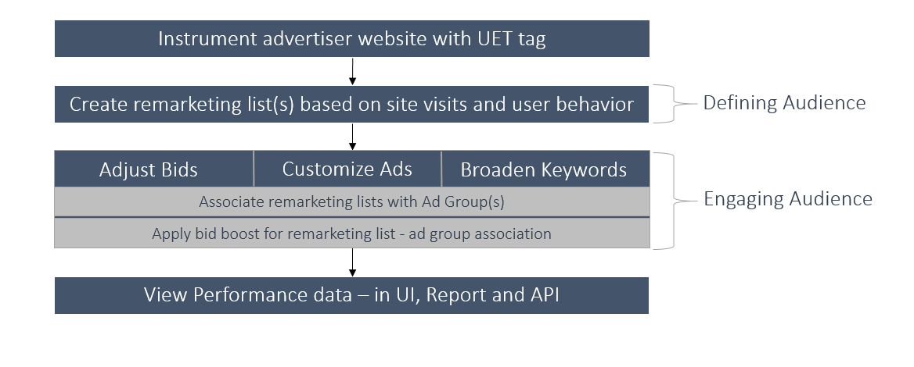
How To Setup Remarketing?

Slide 6
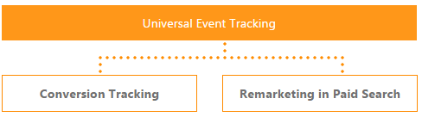
What Is Universal Event Tracking (UET)?
UET is a powerful Bing Ads tool which enable capturing what customers do on a website
Bing Ads collects data that enable conversions tracking (like purchases, or leads), or target specific audiences using remarketing lists
UET is a prerequisite for conversion tracking and remarketing in paid search

Slide 7
Define Right Audience With Remarketing List
Remarketing lists for search is a feature that enables advertisers to customize search ads campaign for people who had previously visited their site.
Remarketing lists are defined at account level. However, their scope can be extended to all accounts under the customer shell
General visitors :
Anyone who had visited any page, even one page, by defining that the URL contains the advertiser’s domain. For example: People who had visited a page with URL: “mysite.com”
Product visitors
Anyone who had visited a specific category page by defining a URL contains a particular product. For example: People who have visited a page with URL : “mysite.com/shoes”
Shopping cart abandoners or lead form abandoners
Anyone who had placed items in a shopping cart or started lead form. For example: People who had visited a page with URL “mysite.com/shoppingcart”
Recent converters
Anyone who had completed a purchase or submitted a lead form. For example: People who had visited a page : “mysite.com/thankyou”
Loyalty members
Anyone who had visited loyalty website. For example: People who have visited a page : “mysite.com/rewardsprogram”

Slide 8
Engage The Audience By Using Right Strategies
Advertisers can use one or a combination of strategies as outlined below:
Increasing / Decreasing Bids
Increase bids by up to 900% and decrease by up to 90% based on audience. For example: increase bids up to +900% to website visitors who had previously abandoned shopping carts as they are high value customers
Tailor ads and landing pages. For example: serving an ad with an offer or discount can help drive conversions to those who had previously visited a category page on the customer’s website
Customize Ads
Serve customized ads to specific audiences as per inclusion in remarketing lists
Serve different ad copies, extensions, and/or landing pages can be good for cross-selling or up-selling additional products to specific audiences. For example: a retailer can create a remarketing list for users who had recently purchased running shoes and use it to cross-sell running apparel products
Add trending keywords to broaden the inventory of keywords by learning from user’s searches

Slide 9
Remarketing Features Details
Remarketing lists* are associated at ad group levels, and can be shared across all accounts under the same customer’s shell
Must have at least 1,000 users in a remarketing list before the list can be utilized
What are Bid adjustments:
Advertisers can use bid adjustments, also known as incremental bids, to increase or decrease their bids for certain target customers. Bid adjustments can target certain demographics such as gender, age, and location. They can also target customers who are searching during certain days and / or time of day
Example : An advertiser wants to improve the odds of showing ads to customers who are 25-34 years old. Their bid on the keyword "shoes" is $1.00. The advertiser adds a 20% bid adjustment for age group 25-34. Now, when a search user in the targeted age range searches for "shoes", the bid is $1.20 and advertiser is more likely to have a winning bid that gets the ads served
An advertiser can have a maximum of 1,000 remarketing lists per account, and 5,000 remarketing lists per customer is allowed
Membership Duration:
When a remarketing list is created, advertisers can specify how far back in time Bing Ads should look for actions that match remarketing list definition in order to add people to their list. This is set to 30 days by default and can be set to any value between 1 and 180 days
* Remarketing list (same as Audience): The advertiser website needs to be instrumented with UET Tags in order for remarketing to work. Remarketing lists do not require conversion goals to be set up. Remarketing lists will be defined at customer level and shared across all accounts within their relative shell
Notes:
Remarketing list : Same as Audience. The advertiser website needs to be instrumented with UET Tags for remarketing to work. Remarketing lists do not require conversion goals to be set up. Remarketing lists will be defined at customer level and shared across accounts

Slide 10
Remarketing Exclusions
Remarketing exclusions allow an advertiser to exclude certain audiences from an ad group
Exclusions allow you to focus on the users who matter most by excluding the types of users who may not fit within the objectives of an ad group.
Below are a few examples where setting up remarketing exclusions could further your audience-targeting objectives and achieve a higher ROI. If you have a campaign set up to generate new sign-ups, you may want to exclude existing customers from ad groups of this campaign.
If your type of business or service entails a long commitment from your customers, then recent customers may not be in the market to buy again for a while, like with buying a car or home.
If you want to focus an ad campaign on a specific stage of the customer purchase experience - for example, with customers who added items to a cart but have not yet made a purchase. In that case, you could use a combination of targeting associations and exclusions to focus on just those users.
If you want to convert free trial users to paid customers, you can exclude customers who are not approaching the end of their trial period for ad groups of that campaign.
For more details, visit this page.
Notes:
Remarketing list : Same as Audience. The advertiser website needs to be instrumented with UET Tags for remarketing to work. Remarketing lists do not require conversion goals to be set up. Remarketing lists will be defined at customer level and shared across accounts

Slide 11
New Audience Types
Custom Audience:
Custom Audiences is a type of remarketing list that is generated by using your own customer data, usually managed by a data provider, to create richer user segments.
When your data provider connects into our new Custom Audiences feature, you can then import your Custom Audience segments into Bing Ads for search remarketing.
For details refer to the following deck:
Uses your data
Custom Audiences allow you to use the audience data you already have.
Creates richer audiences
You can create richer audience segments using more of your customer data.
Works like remarketing
Custom Audiences can be associated to ad groups as target and bid, bid-only, or as an exclusion.
In Market Audience:
With In-market Audiences, you can find curated lists of users that have been determined to be in-market for a particular purchase category. When these In-market Audience lists are associated to ad groups, you can target and modify bids for these audiences, similar to Remarketing lists
Verticals such as apparel, auto, beauty, education, employment etc are currently available.
For the complete vertical list and more details on in-market audience, refer to this deck

Slide 12
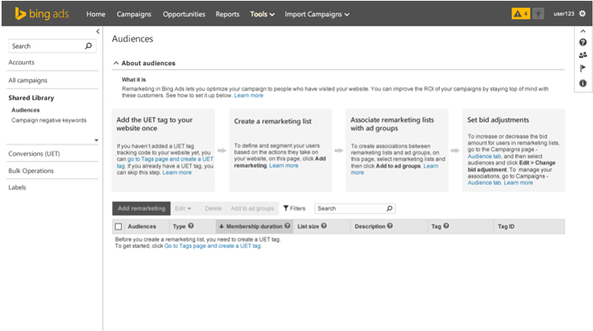
How To Setup Remarketing In Bing Ads?
Process Overview

Slide 13
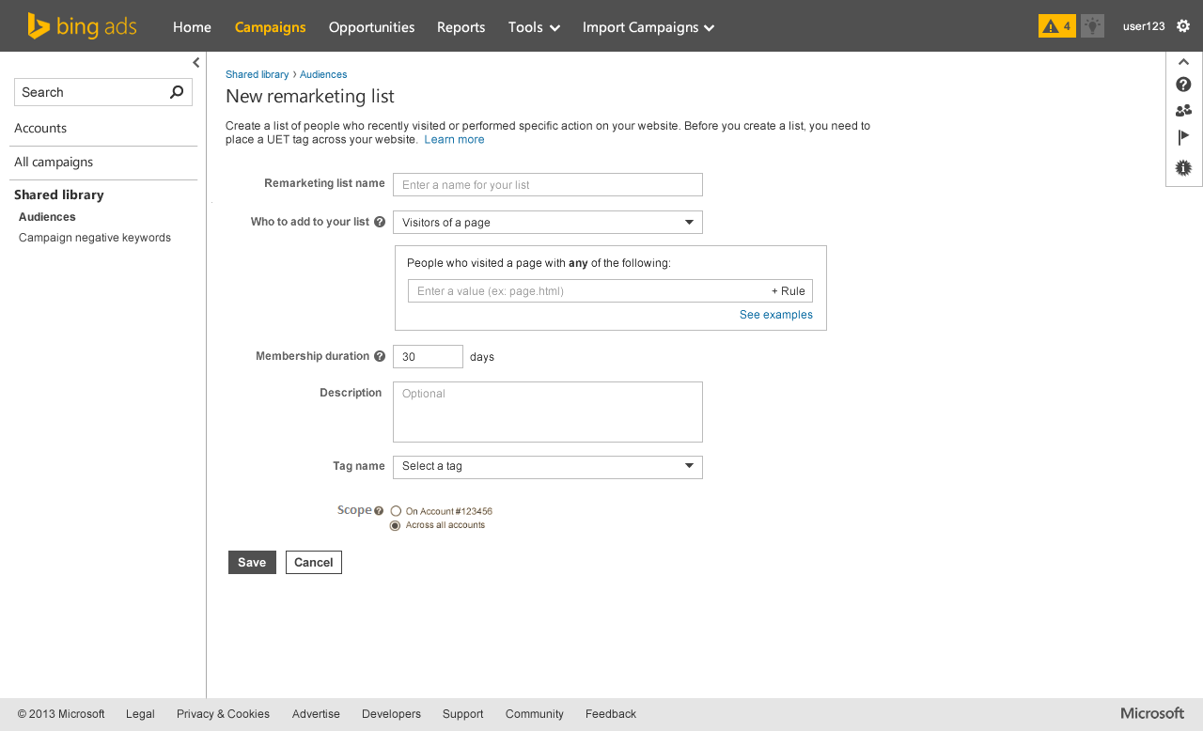
Step 1: Create Remarketing Lists (1)

Slide 14
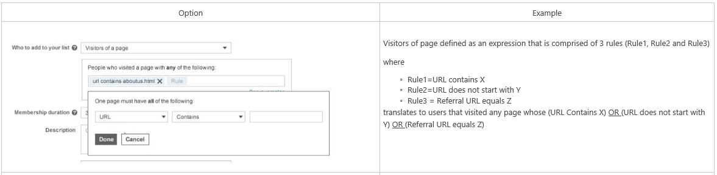
Create Remarketing Lists (2)
Use various rules to add end users to the remarketing list:

Slide 15
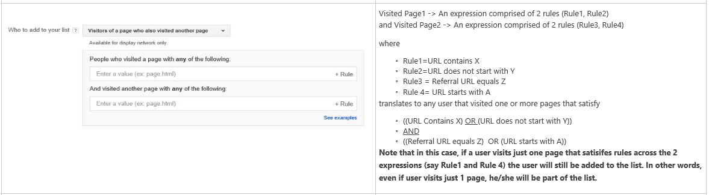
Create Remarketing Lists (3)
Use various rules to add end users to the remarketing list :

Slide 16
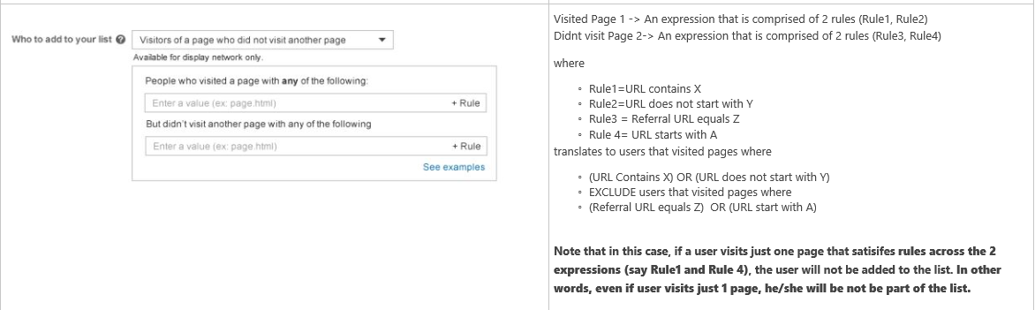
Create Remarketing Lists (4)
Use various rules to add end users to the remarketing list :

Slide 17
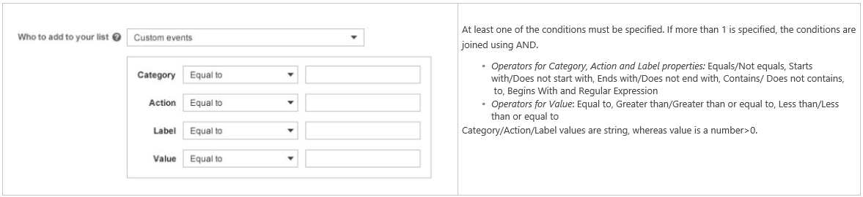
Create Remarketing Lists (5)
Use custom rules to add end users to the remarketing list :

Slide 18
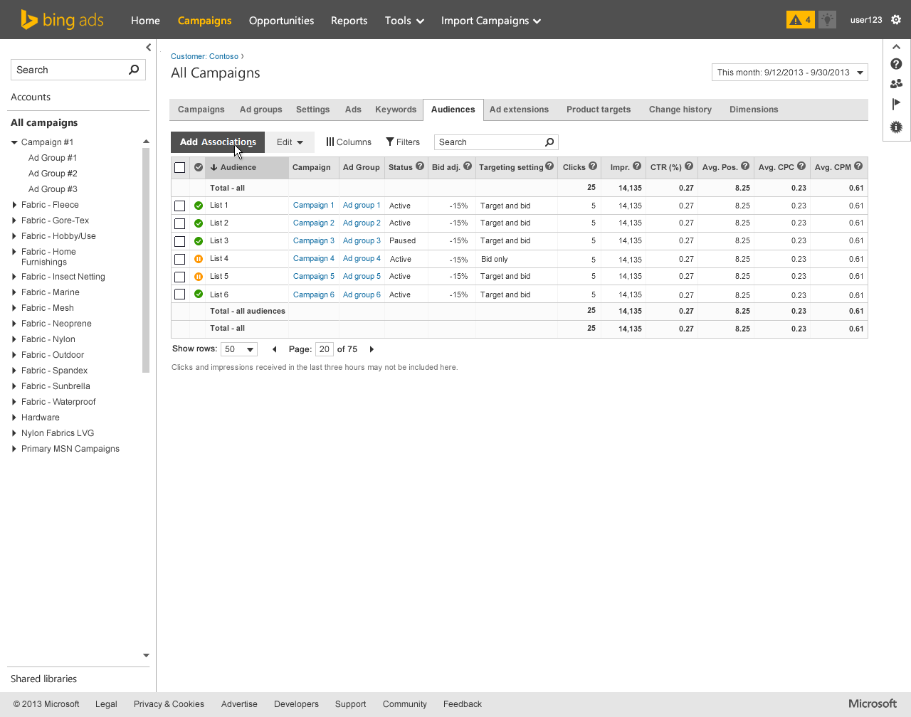
Step 2: Associate Remarketing Lists With Ad Groups (1)
Association refers to the mapping of a remarketing list and ad group
Associations can be created in a many-to-many manner i.e. one ad group can be associated with multiple remarketing lists and vice versa

Slide 19
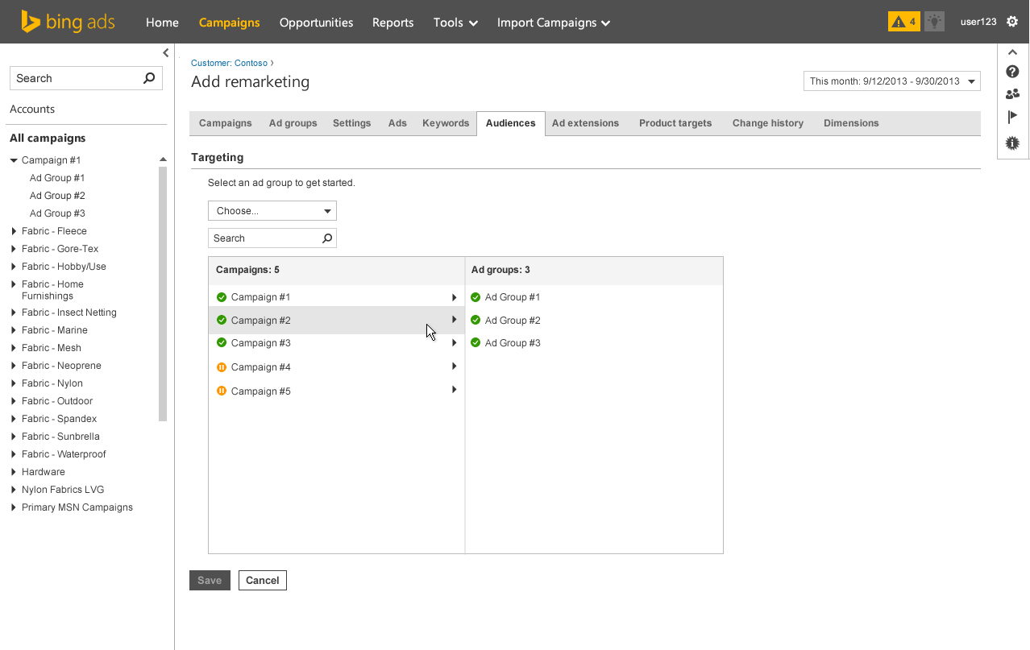
Associate Remarketing Lists With Ad Groups (2)

Slide 20
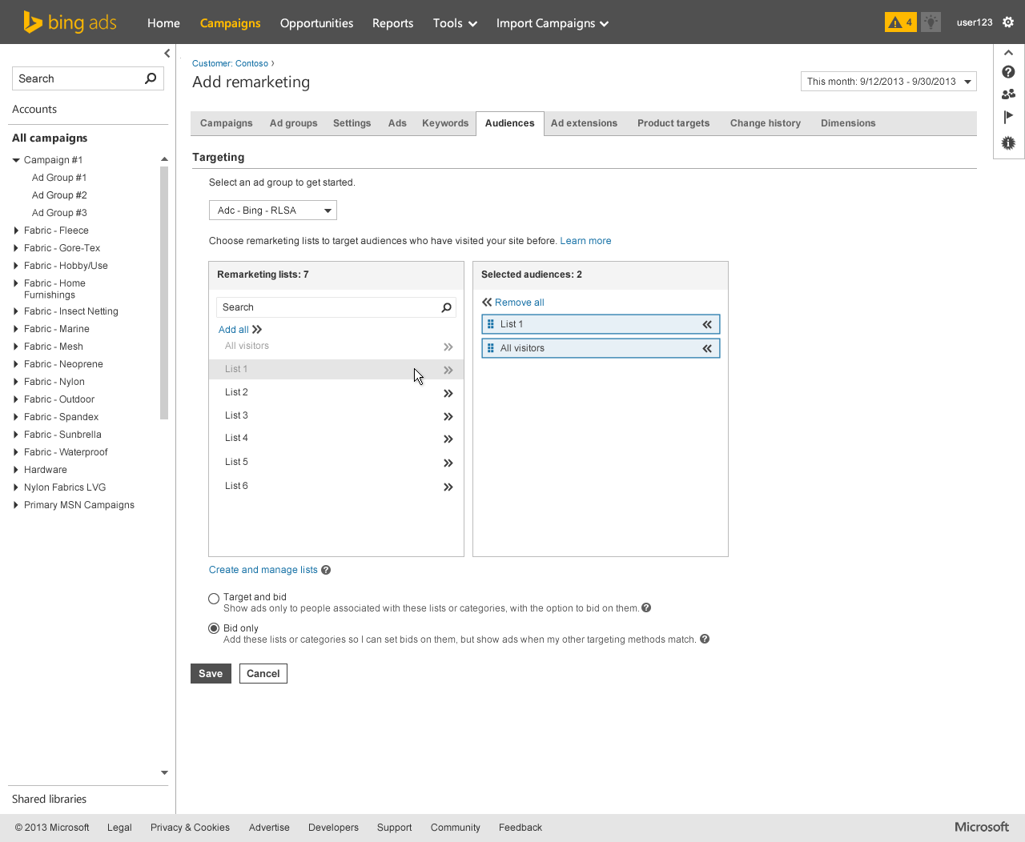
Associate Remarketing Lists With Ad Groups (3)

Slide 21
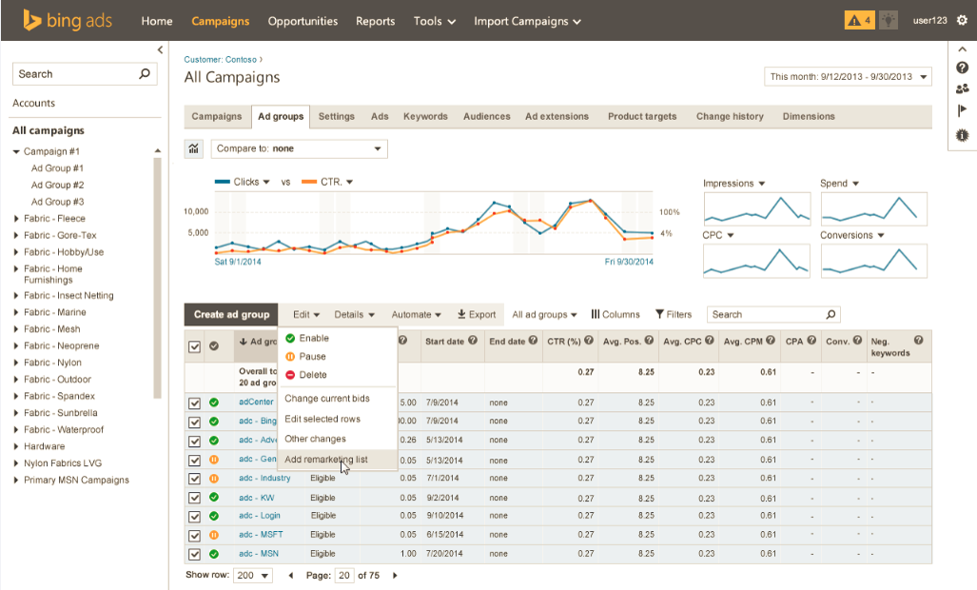
Step 3: Create associations In Bulk

Slide 22
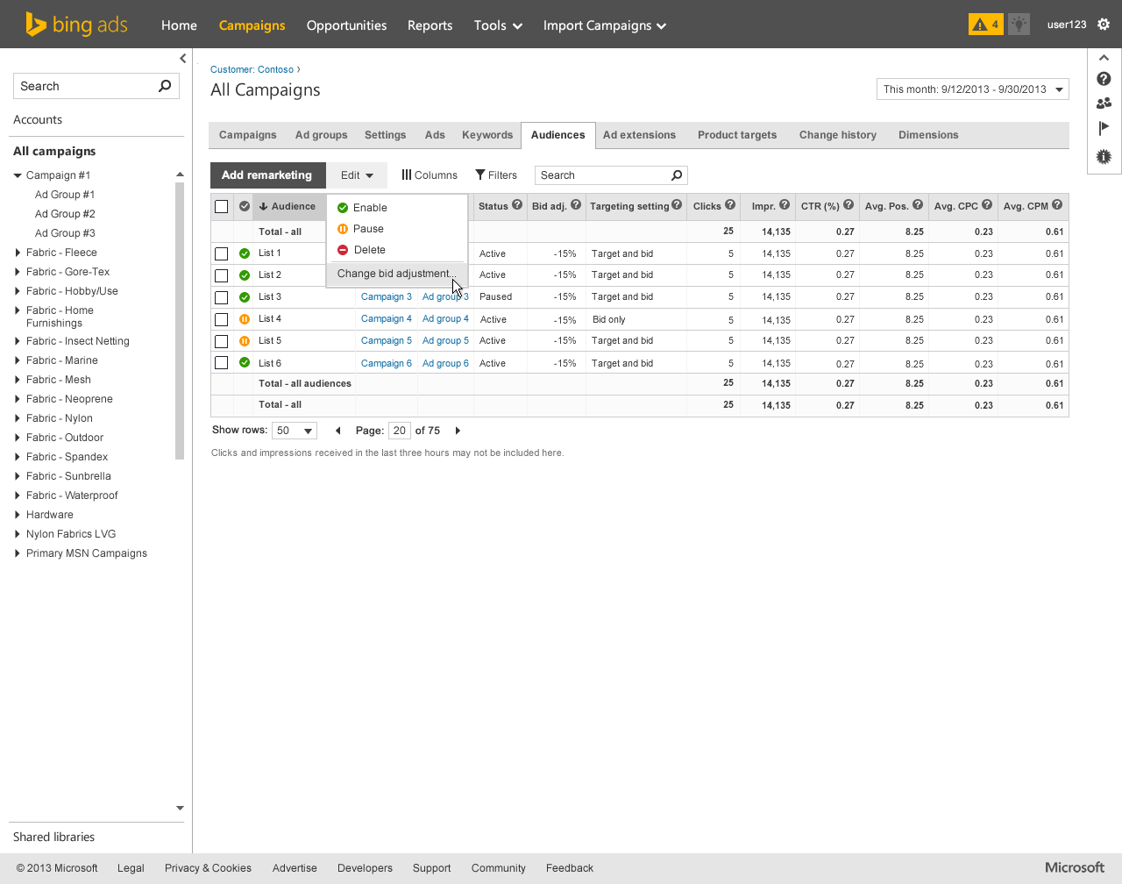
Edit Existing Associations
Pause, enable or delete remarketing list association:

Slide 23
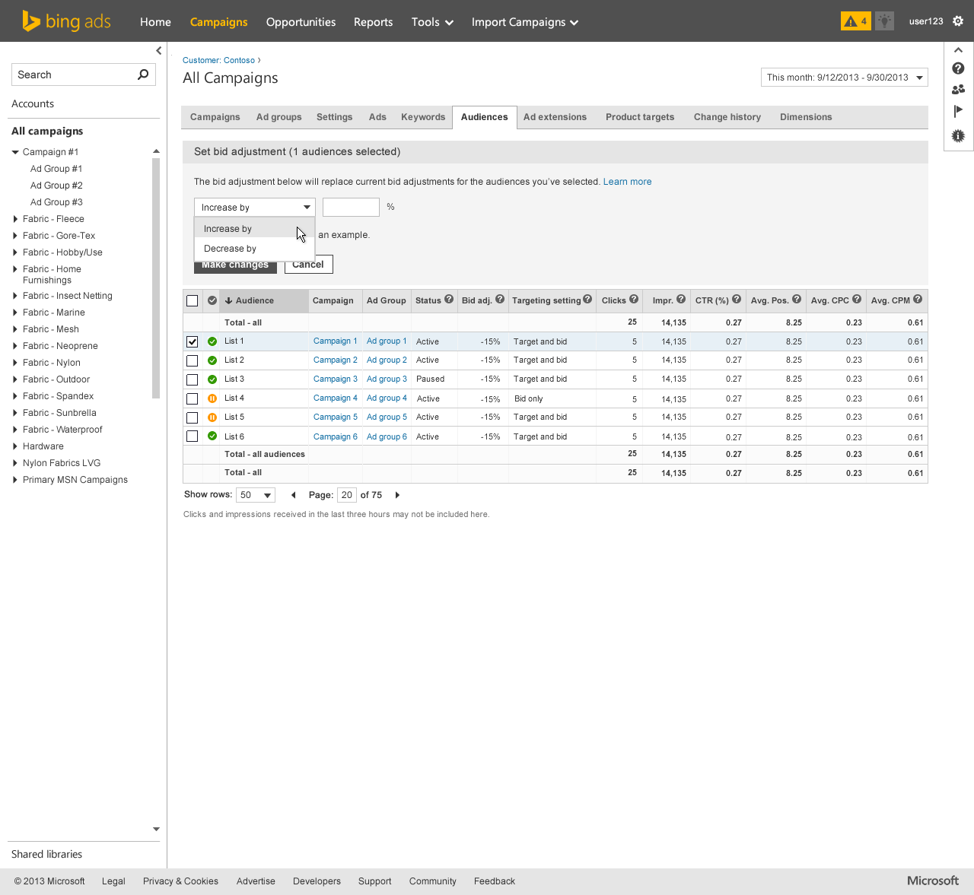
Step 4: Set Bids
Setup bid boost: Percentage of bid amount increase / decrease for the audience associated with a remarketing list

Slide 24
Remarketing Examples
Optimize bids and ads based upon the journey or path of end users:
Adjusting Bids
Customizing Ads
Home page
Increase bids by 50%
“Discover new deals”
Category page
Increase bids by 100%
“25% off today”
Product page
Increase bids by 150%
“limited time offer”
Shopping cart
Increase bids by 900%
“Free shipping”
Thank you pages
Increase bids by 200%
“Have you tried…”

Slide 25
Remarketing Examples
Broaden keywords and expand match types to qualified audiences:
Remarketing campaigns
Traditional campaigns
Home page
competitor brand term
your brand term
Home page
vacations
[vacations]
Category page
best hotels
“hotel deals”
Product page
hotels
hotels in seattle

Slide 26
Appendix

Slide 27
Links
BingAds Marketing Features Guide
A repository of all the knowledge documents for Remarketing
https://microsoft.sharepoint.com/teams/BingAdsRemarketing/SitePages/Feature%20Guide.aspx

Slide 28
FAQs
How is Remarketing adoption determined?
Main stages of adopting remarketing are
Creation of remarketing lists
Associating them with ad groups
Remarketing can start functioning only when association is made and remarketing lists cross 1000 members. So complete adoption can be done only after association is created
What is active and performing adoption in Remarketing?
When an advertiser creates Remarketing list, it refers to active adoption.
When advertiser creates association, it refers to performing adoption.
Note that creating association does not mean that advertiser will be able to show remarketed impressions

Slide 29
FAQs
Can single user be present in multiple Remarketing lists?
Yes. Remarketing lists are created using rules set by advertiser. One user can pass multiple rules.
Consider an example where a single user books tickets as well as signs up for newsletter. This user can become part of two remarketing lists created for 2 different purposes
Can an ad group be associated with multiple Remarketing lists?
Yes. Multiple remarketing lists created using different rules can work towards same business objective.
If an ad-group serves the purpose of fulfilling that objective, remarketing can be done by associating these lists to the same ad group

Slide 30
FAQs
What is meant by membership duration?
Remarketing lists are created by adding end users who fulfill a certain criteria. But remarketing and showing similar ads to them again makes sense only for certain time.
For example: an automobile advertiser might have more than 30 days of membership duration, while a clothing retailer might have 2 days.
Membership duration is the time limit after which a user will no longer be part of a particular remarketing list. This duration starts separately for every user after it gets added to remarketing list.
Why does remarketing list does not become active unless it has 1000 users? Remarketing does not target a particular user as that would be too specific. Rather, it targets users with particular characteristics. Hence, unless remarketing list has high number of end users, it does not get activated
Can you move remarketing list from one to another account?
Yes. Remarketing list can be easily moved from one to another account under same customer

Slide 31
FAQs
What is difference between Bid Only vs. Target and Bid remarketing strategy?
Advertisers can add remarketing lists to existing campaigns and set them to Bid Only. The benefit here is to set custom bids for certain audiences (Example: Bid up on past customers).
However, the advertiser will then be using the same keywords for new visitors as well as previous visitors who have become members of their related remarketing lists.
Advertisers can also create new different campaigns and set them to Target and Bid. This enables them to utilize broad keywords for users in their relative remarketing lists. (Example: A user views a page on the advertiser’s website about a used Toyota Camry. The customer can then bid on that user when they search for a broad term like "used car" since the advertiser knows that such users had shown interest in their make / model)

Slide 32
Additional Considerations (1)
What should be the impact of Remarketing on CTR, CPC and revenue of the advertiser?
What should be the impact of positive, 0 and negative bid boost on CTR, CPC and revenue of advertiser?
What is the level at which Remarketing is adopted? What about UET?
Which tab in BingAds UI contains shortcut to create Remarketing list?
How does Remarketing work?
What is the purpose of 0 and negative bid boost in remarketing? Explain with example
Mention any 3 positive and negative points for Remarketing
Design an experiment which advertiser could perform to come up with appropriate bid boost

Slide 33
Additional Considerations (2)
Which bid boost is suitable for remarketing end user who has purchased your product? Mention reason with the choice (multiple choice)
Positive
Negative
0
Conversion rate of an advertiser is decreasing. How can Remarketing help this advertiser? (multiple choice)
Remarketing can suggest where conversions are lost
Remarketing can help advertiser target high conversion prone end users
Remarketing can increase the bid of advertiser for all impressions
Its worthless to use Remarketing here without pausing the campaign for 1 week
Advertiser sees increase in CPA and decrease in CVR due to Remarketing. What should he do? (multiple choice)
Decrease the incremental bid boost percentage
Decrease the membership duration of his remarketing list
Change the rule for creating remarketing list
Increase the membership duration of his remarketing list

Slide 34
Additional Considerations (3)
How is remarketing different from other targeting settings?
Remarketing work with bid boost
Remarketing requires UET
Remarketing has -100% bid boost
Remarketing has ad-copy modification
True or false: Advertisers with daily budget should not use Remarketing as it will budget pause the campaign
True or false: Remarketing works only when end user has completed 7 days in remarketing list

